Slide 1
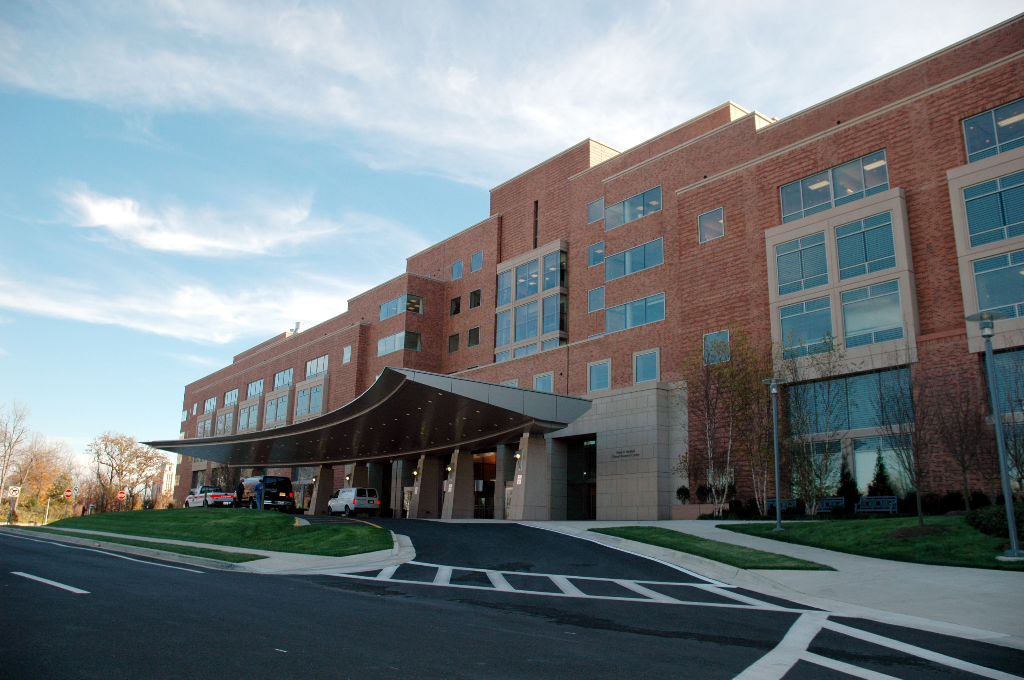
CureHaven
Hospital
Team Members
RICHA (04015602722)
AKRITI SINGH (04115602722)

Slide 2
THEME
To create an Integrated World Class Healthcare System, Fostering, Protecting, Sustaining and Restoring Health through Best in Class Medical Practices and Cutting Edge Technology developed through in depth Research.
•Develop, apply, evaluate and share new technology
• Deliver world class patient care services
•Excel in the delivery of specialized medical care supported by comprehensive research and education
VISION
MISSION

Slide 3
SOFTWARE SPECIFICATION
HTML - HTML or Hypertext Markup Language is the standard markup language used to create web pages. HTML is written in the form of HTML elements consisting of various tags. It describes the structure of a website.
CSS - CSS or Cascading Style Sheets is a style sheet language used for describing the look and formatting of a document written in markup language .
JAVASCRIPT - JavaScript is the scripting language of the web . All modern HTML pages are using JavaScript . It is used to specify the behavior of web pages.

Slide 4
SAMPLE SCREENSHOTS

Slide 5
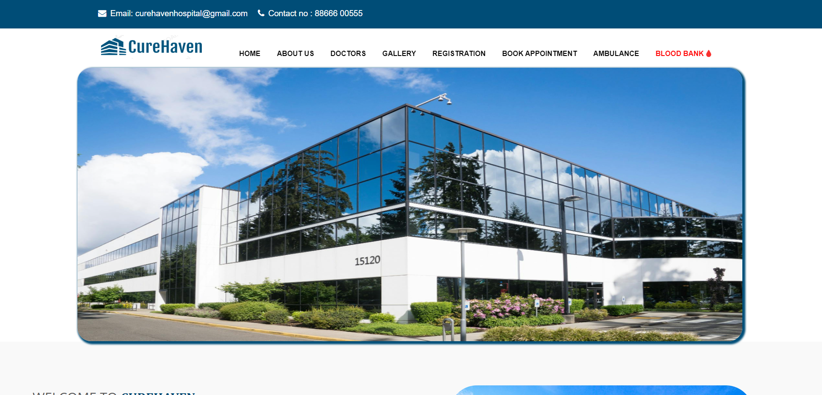
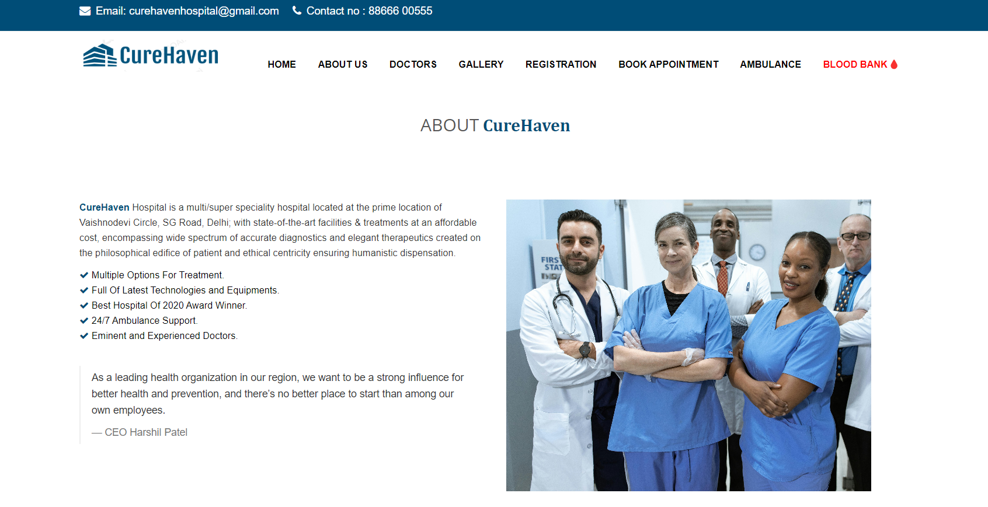
MAIN SCREEN
HOME PAGE
ABOUT US

Slide 6
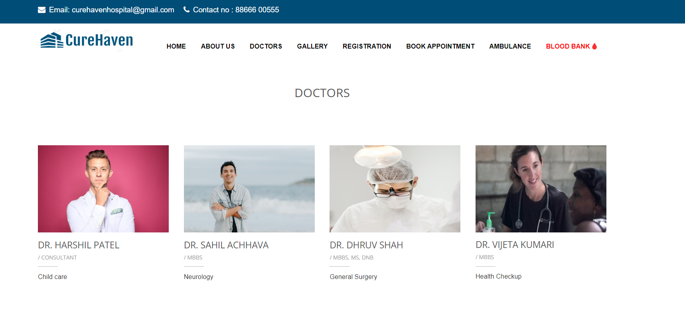
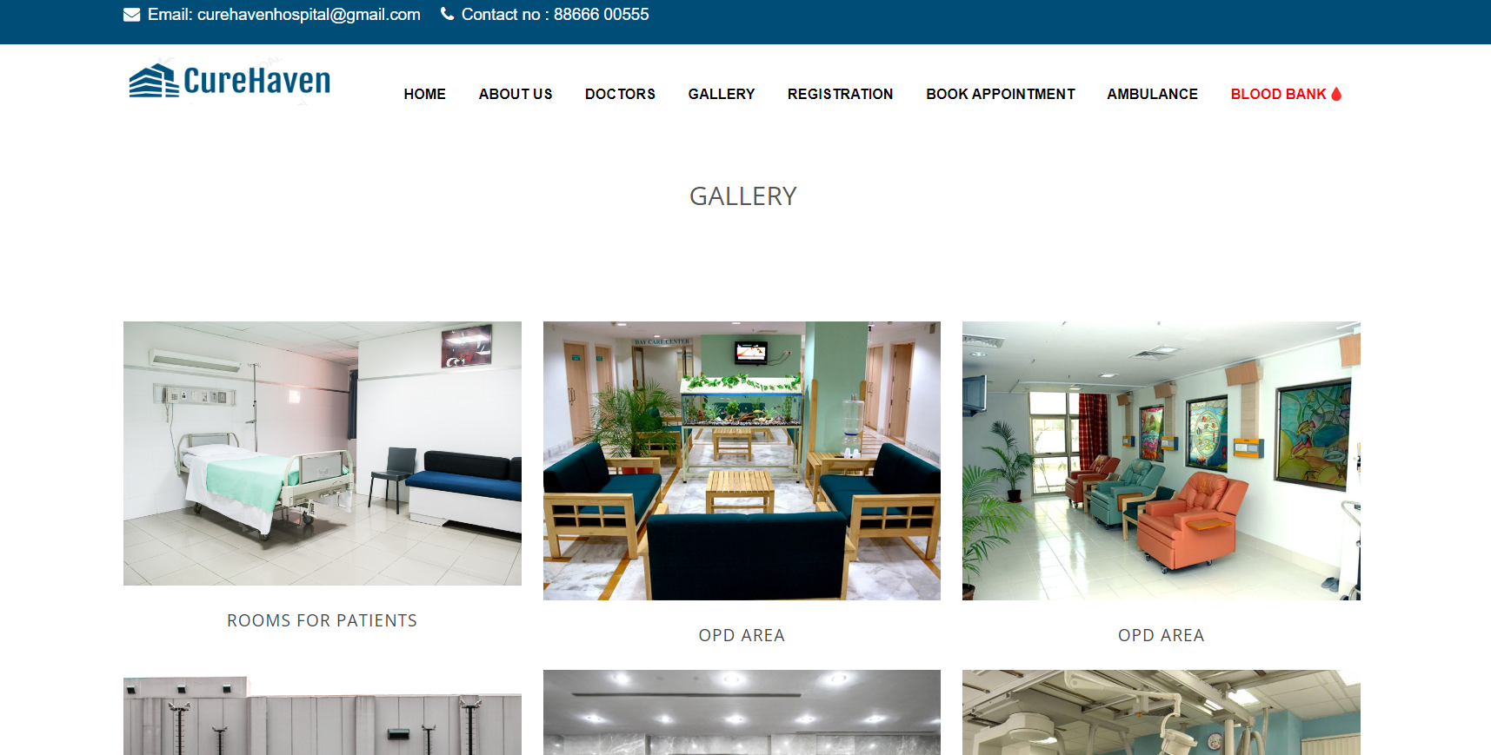
MAIN SCREEN
DOCTORS
GALLERY

Slide 7
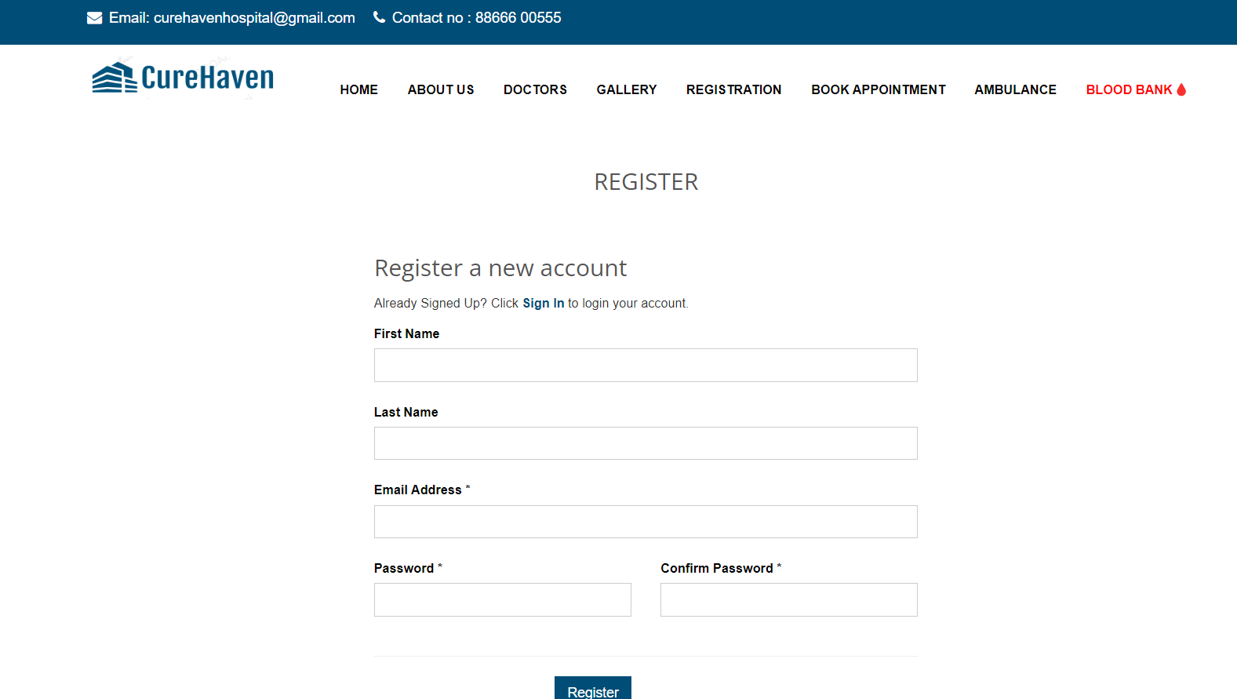
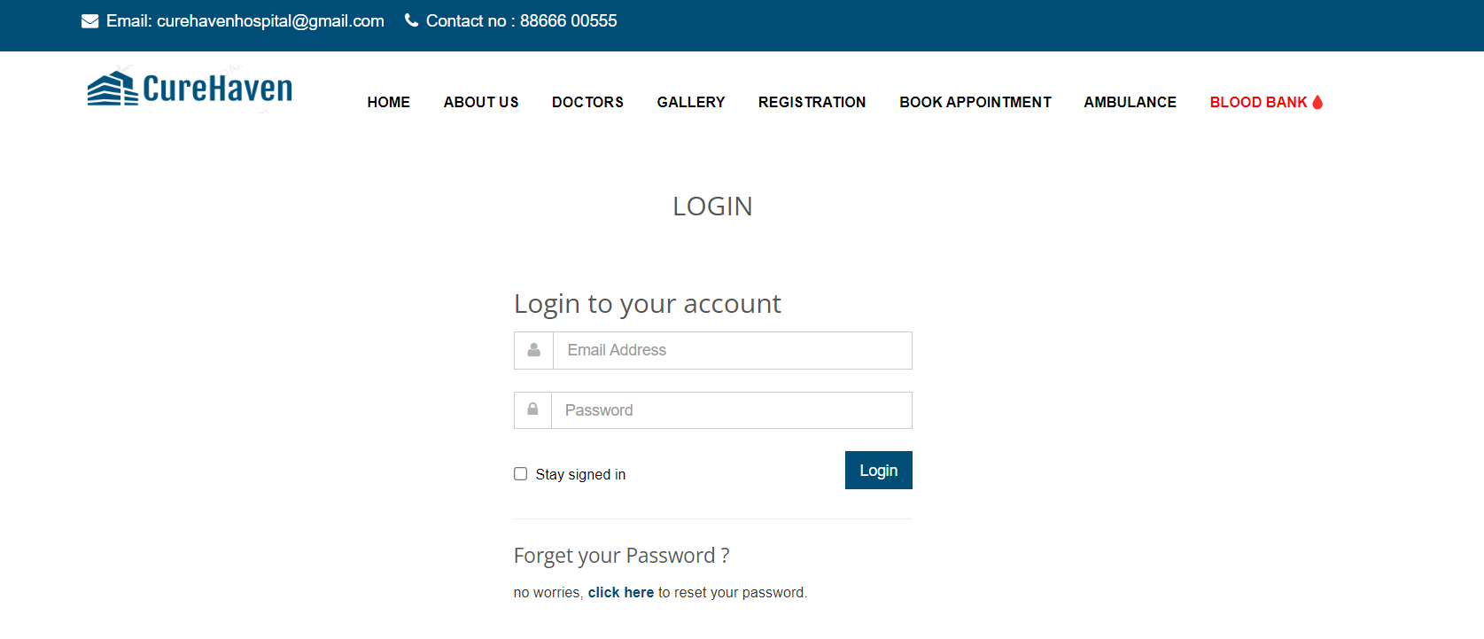
MAIN SCREEN
REGISTRATION
LOG – IN PAGE

Slide 8
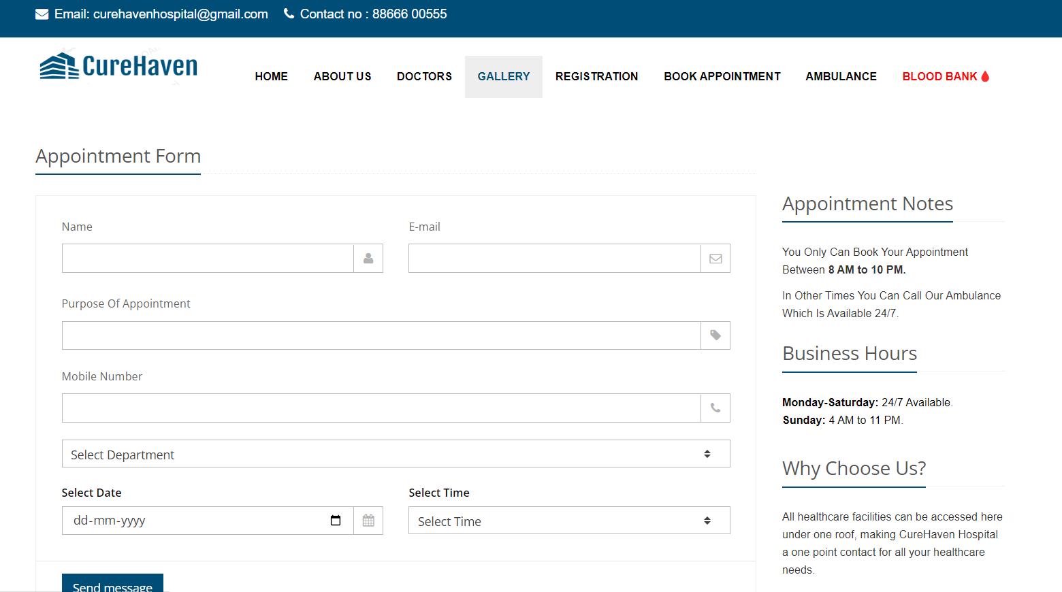
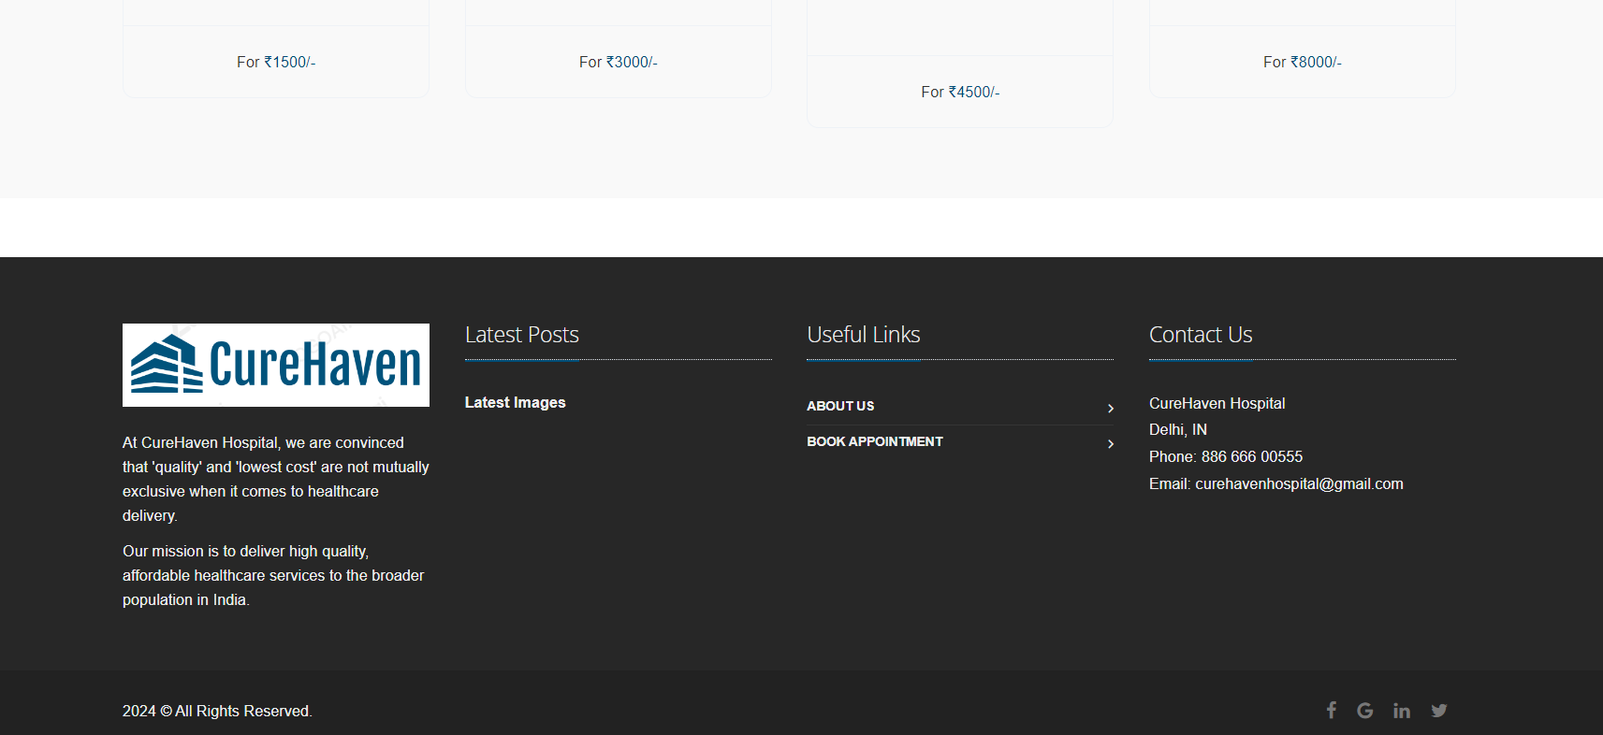
MAIN SCREEN
BOOK APPOINTMENT
FOOTER

Slide 9
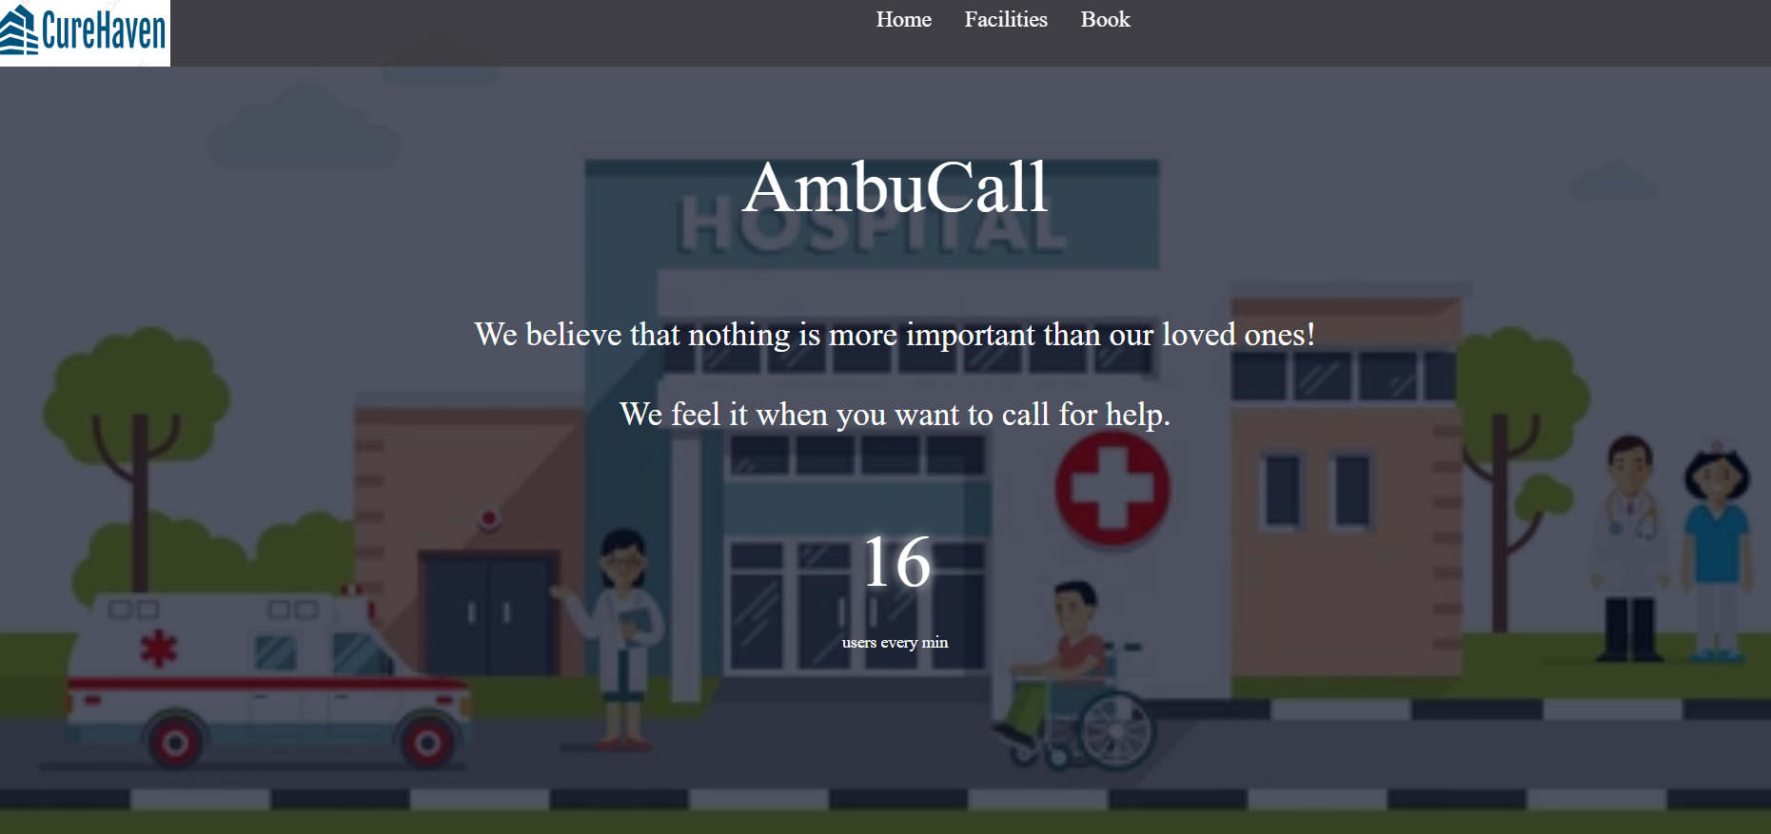
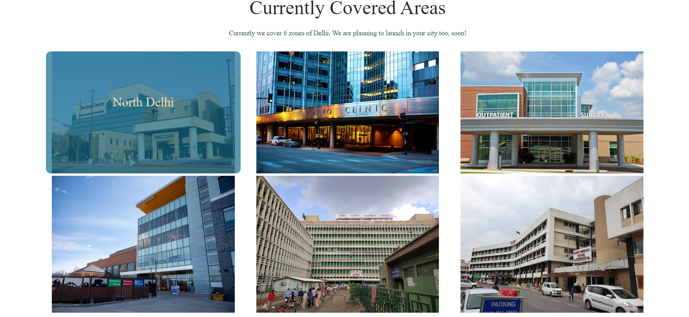
AMBULANCE
HOME PAGE
AREA COVERAGE

Slide 10
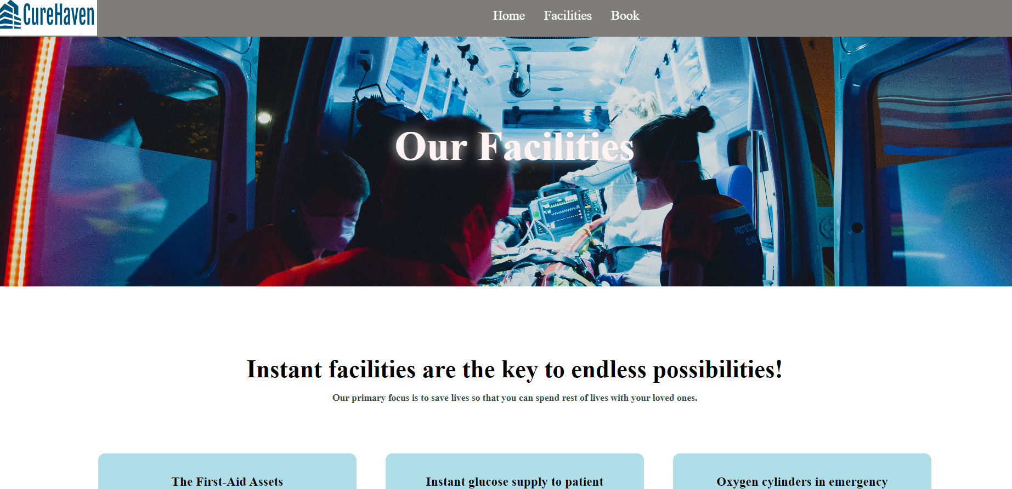
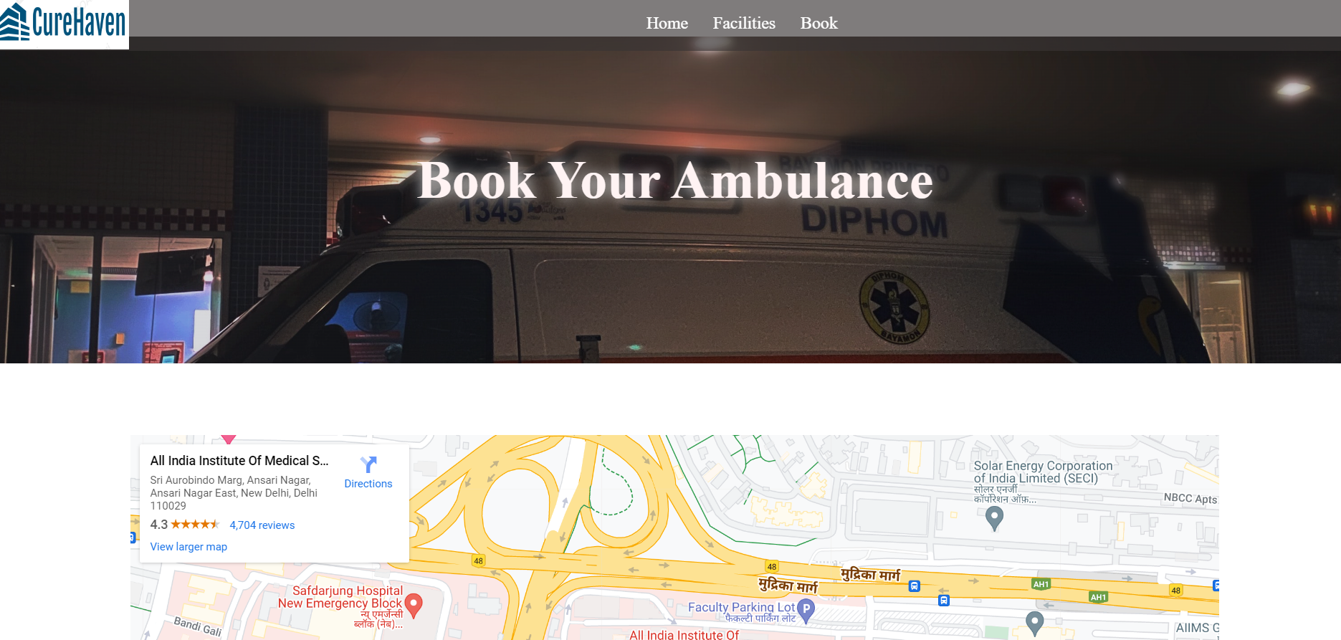
AMBULANCE
FACILITIES
BOOKING

Slide 11

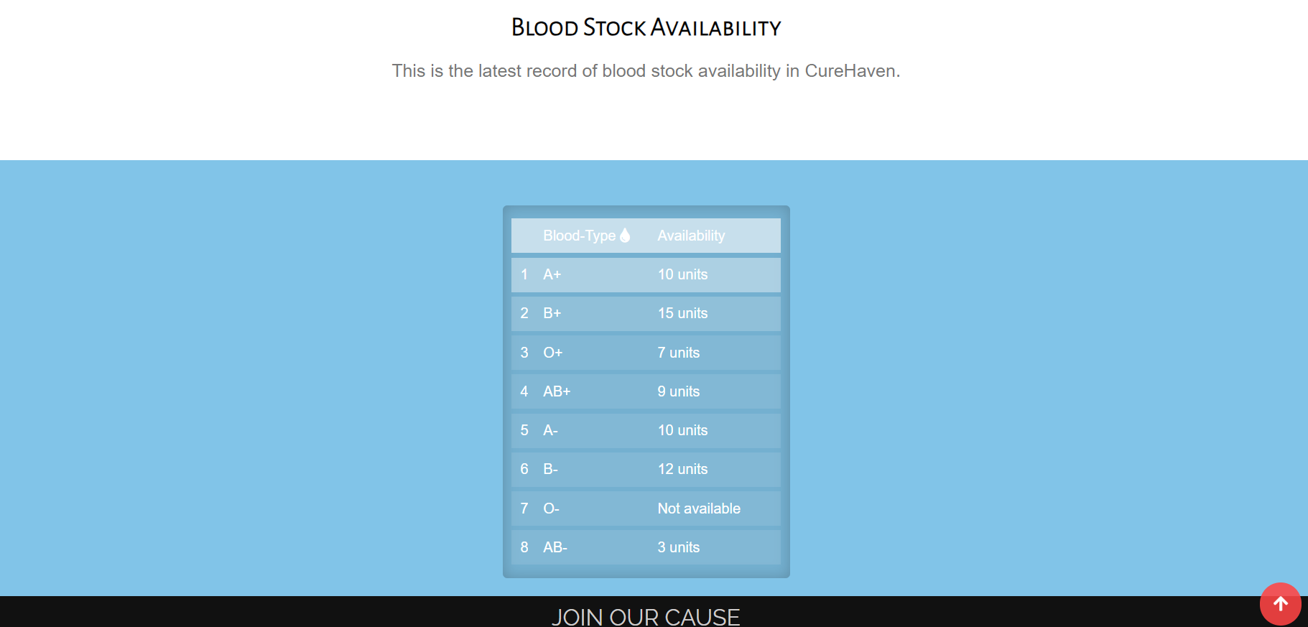
BLOODBANK
HOME PAGE
BLOOD STOCK

Slide 12
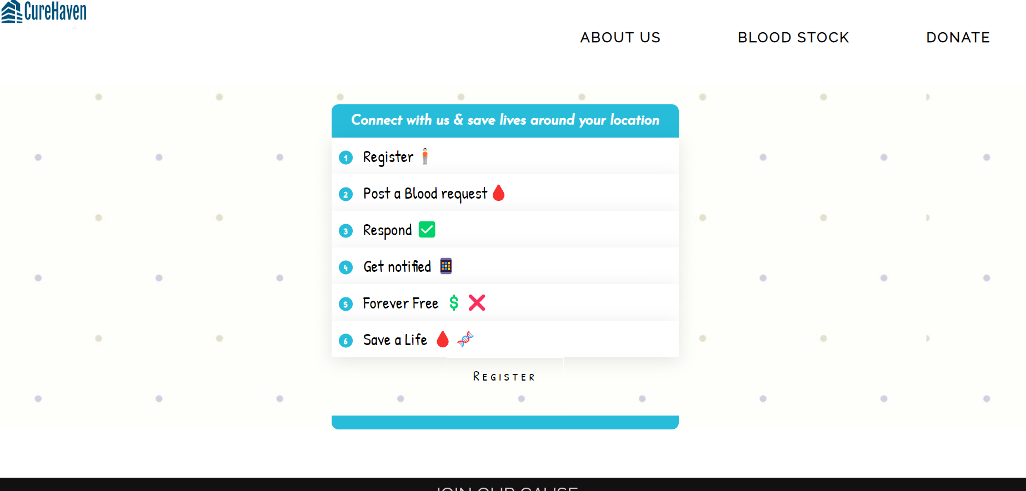
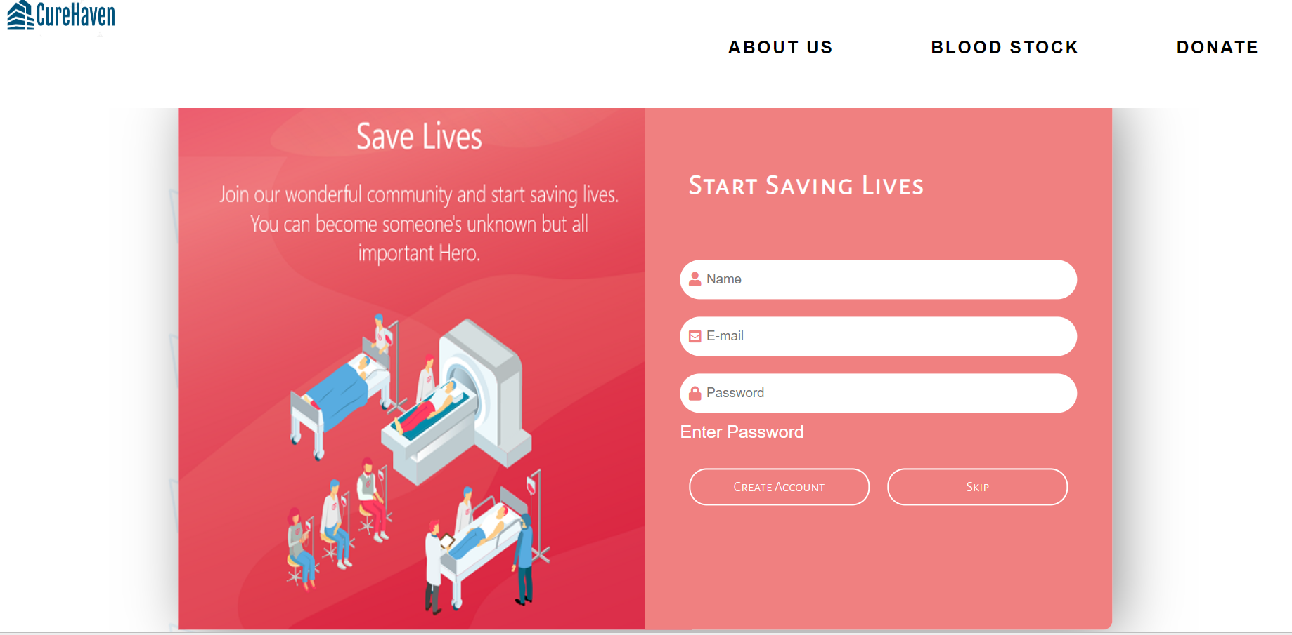
BLOODBANK
BLOOD DONATION
REGISTRATION

Slide 13
ADVANTAGES
TIME SAVING TECHNOLOGY
IMPROVED PATIENT CARE MADE POSSIBLE
FACILITY MANAGEMENT
REDUCES THE WORK OF DOCUMENTATION

Slide 14
FUTURE SCOPES
Users can signup/login using their social media accounts
UI for Payment Method
Medication remainders and teleconsultations

Slide 15
THANK YOU!!!

